Slide 1
Scope and Vision
Phoenix
Ambulatory Blood Pressure Monitoring System
© 2009 Christopher J. Adams
This work is licensed under the Creative Commons Attribution 3.0 Unported License.
To view a copy of this license, visit http://creativecommons.org/licenses/by/3.0/ or send a letter to Creative Commons, 171 Second Street, Suite 300, San Francisco, California, 94105, USA.

Slide 2
Table of Contents
Mission
Scope
Stakeholders
Goals & Goal Conflicts
Dictionary
Scenarios, Stories, Use Cases & Exceptions
Requirements
Justifications
Assumptions
Agreed Priorities
Acceptance Criteria
Parking Lot

Slide 3
Mission
Develop an ambulatory blood pressure monitor
  Inexpensive
  Unobtrusive
  Easy to use
  Collects a week of blood pressure measurements
Develop a means for chronobiological analysis of the collected blood pressure measurements

Slide 4
Mission
Be a learning community
  IEEE study group
  Open source
Deliver the monitor and analytic framework to the Halberg Chronobiology Center
  For long term use on massive scale to
    Obtain measures of health
    Encourage the development of techniques for
      Diagnosis
      Prevention
      Treatment

Slide 5
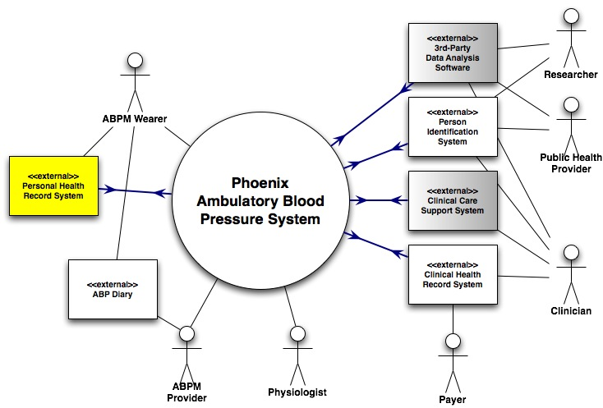
Scope

Slide 6
Scope
System measures the Wearer
Wearer records observations in the Diary
Provider assesses the data collected by the System
Physiologist models blood pressure profiles needed by the assessment methods
Diary influences the interpretation of the data
Wearer optionally tracks results in a Personal Health Record System
Clinical settings ⇒ data stored in Medical Record System
Wearer de-identified to assure privacy ⇒ Person Identification System

Slide 7
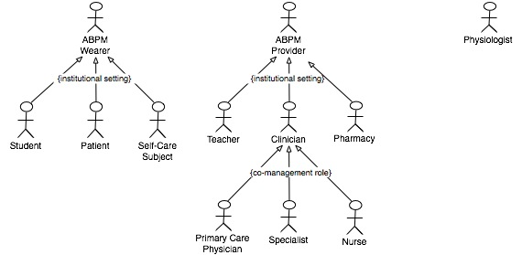
Stakeholders
Actors

Slide 8
Stakeholders
http://www.phoenix.tc-ieee.org/014_Systems_Architecture_and_Engineering/all-in-one.html#requirements

Slide 9
Goals & Goal Conflicts
Make a monitor that is
  Inexpensive
  Unobtrusive
  Easy to use
  Collects a week of blood pressure measurements

Slide 10
Goals & Goal Conflicts
Inexpensive
  Price not a barrier to use
  Less expensive than blood pressure cuff
  Less expensive than wrist watch
    < US$50
  Less expensive than “two bushels of yams”
    Third-world friendly
    < US$10

Slide 11
Goals & Goal Conflicts
Unobtrusive
  When wearing monitor, patient can
    Forget about, be unaware of device
  No more encumbering than
    Wrist watch
    Band-aid™
    Piece of jewelry
  Usable wherever the patient is
    At home
    At work when allowed
    Not only at hospital, clinic or doctor's office

Slide 12
Goals & Goal Conflicts
Easy to use
  Easier to use than current:
    Blood pressure cuffs
    Home BP monitors
  Patient can:
    Ignore device
    Determine that device is functioning normally
    Observe a blood pressure and heart rate measurement
  Device
    Is automatic
      measurements taken regardless of patient behavior
    Allows manually initiated measurements

Slide 13
Goals & Goal Conflicts
Collects a week of blood pressure measurements
  Must measure
    Systolic and diastolic blood pressure
    Heart rate
  At least as accurate as current:
    Blood pressure cuffs
    Home blood pressure monitors
  Would also like to measure
    Physical activity
      To determine if vigorous body movement, such as physical exercise, influenced the blood pressure measurement
    Blood flow
  Records measurements
    at least every half hour
    for at least 7 days

Slide 14
Goals & Goal Conflicts
The Halberg Chronobiology Center wants the monitor
  For long term use on massive scale
  To obtain measures of health
  To encourage the development of diagnostic, prevention and treatment techniques

